Slide 1
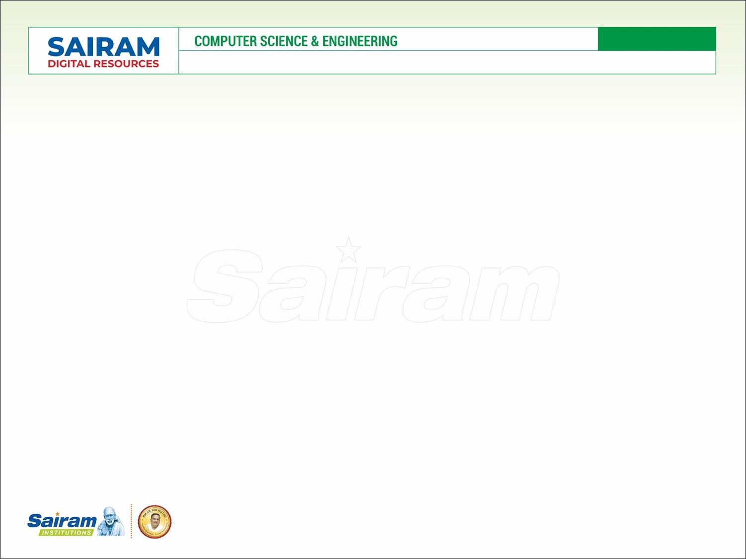

SUBJECT CODE
TYPE THE SUBJECT NAME HERE
ZEROTH REVIEW
Name : KARTHICK M
Reg. Number : 412419104049
Name : TARUN H
Reg. Number : 412419104137
Name : SYED ABUTHAHIR A
Reg. Number : 4124191040136
ORDER AND DEMAND FORECASTING THROUGH CUSTOMER BEHAVIOR AND SEASONAL PATTERN WITH RISK ADJUSTED
IV
VIII
CS8611
PROJECT GUIDE : PRABAHAR GODWIN JAMES
MAJOR PROJECT

Slide 2
CS8811
MAJOR PROJECT – ZEROTH REVIEW
PROBLEM STATEMENT
The Dynamic nature of the retail stores or warehouses.
Bull Whip effect in the supply chain network.
Reduced visibility due to inaccurate knowledge of demand and inventory.
Higher levels of demand and forecast uncertainty will result in excess inventory stock and also a loss in the firm’s profitability.
Inability to handle the disruptions as soon as it occurs in the supply chain network.

Slide 3
CS8811
MAJOR PROJECT – ZEROTH REVIEW
OBJECTIVE OF THE PROJECT
Improving the financial planning of the system which lays out necessary steps to generate future income and cover future expenses.
Reducing the impact of disruption in traditional dynamic forecasts.
Accurate order forecasting and dynamic BE forecasts.
Overcoming the bullwhip effect by coming up with an enhanced forecasting model which predicts accurate results.
Enable the organization to estimate the future quantity and quality of people required for material production.
Sales strategy which is faced by retailers can be done using power pricing policy.

Slide 4
CS8811
MAJOR PROJECT – ZEROTH REVIEW
EXISTING SYSTEM
It uses CNN – LSTM model to forecast the product demand.
It will work only for the passed input data.
LIMITATION
Inefficient forecasted data
Failed to reduce the accuracy of the bullwhip effect.
Information sharing in the supply chain is not effective.
Due to restrictive data flow customer demand information is not known through different supply chain partners.

Slide 5
CS8811
MAJOR PROJECT – ZEROTH REVIEW
PROPOSED SOLUTION
Implementing machine learning techniques to forecast product demand in a more accurate way.
Implementing the RNN-LSTM model in particular for better forecasts.
This RNN will use the output of the previous input data along with local state variable.
Reducing the bullwhip effect in the supply chain as much as possible.
Encouraging cross-border data flow for effective communication.

Slide 6
CS8811
MAJOR PROJECT – ZEROTH REVIEW
REVIEW OF LITERATURE
SL NO | TITLE OF THE PAPER | TECHNOLOGY | JOURNAL NAME | YEAR
1 | Customer Order Behavior Classification via Convolutional Neural Network in the semi conductor industry. | Machine Learning | IEEE TRANSACTIONS ON SEMICONDUCTOR MANUFACTURING, VOL. 35, NO. 3, AUGUST 2022 | 2022
2 | A Novel Dynamic Demand Forecasting Model for Resilient Supply Chains using Machine Learning | Machine Learning | 2021 IEEE 45th Annual Computers, Software and Applications Conference (COMPSAC) | 2021
3 | Machine Learning Model for Sales Forecasting by using XGBoost | Machine Learning | 2021 IEEE International Conference on Consumer Electronics and Computer Engineering (ICCECE 2021) | 2021

Slide 7
CS8811
MAJOR PROJECT – ZEROTH REVIEW
REVIEW OF LITERATURE
SL NO | TITLE OF THE PAPER | TECHNOLOGY | JOURNAL NAME | YEAR
4 | Sales Prediction based on Machine Learning. | Machine Learning | 2021 2nd International Conference on E-Commerce and Internet Technology (ECIT). | 2021
5 | Sales Forecasting for Supply Chain demand management – A Fuzzy time series approach | Machine Learning | 2019 13th International Conference on Mathematics, Actuarial Science, Computer Science, and Statistics. | 2019
6 | Sales Forecasting of Retail Stores using Machine Learning Techniques. | Machine Learning | 3rd IEEE International Conference on Computational Systems and Information Technology for Sustainable Solutions 2018 | 2018

Slide 8
CS8811
MAJOR PROJECT – ZEROTH REVIEW
JUSTIFICATION FOR SDG
Decent work and economic growth (SDG GOAL NO : 8)
Since the demand is already known the workforce can either be laid off or put to overtime only when required
Industry, innovation, and infrastructure (SDG GOAL NO : 9)
Increase the access of small-scale industrial and other enterprises, particularly in developing countries aiding financial growth, including affordable credit, and their integration into value chains and markets.
Responsible consumption and production (SDG GOAL NO : 12)
Since we only procure as many raw materials as we require for production, the wastage is significantly reduced.

Slide 9
CS8811
MAJOR PROJECT – ZEROTH REVIEW
INNOVATION IN THE PROJECT
Analysing and classifying Customer Order Behavior (COB)
Increased profit of the organization due to the advancement in the prediction of future sales.
Solving the bullwhip effect in the supply chain network.
Automation in the raw material purchase system for defective products/items.
Stock management in the retail store to meet the customer demand
Implementation of a fully transparent system between different supply chain users.

Slide 10
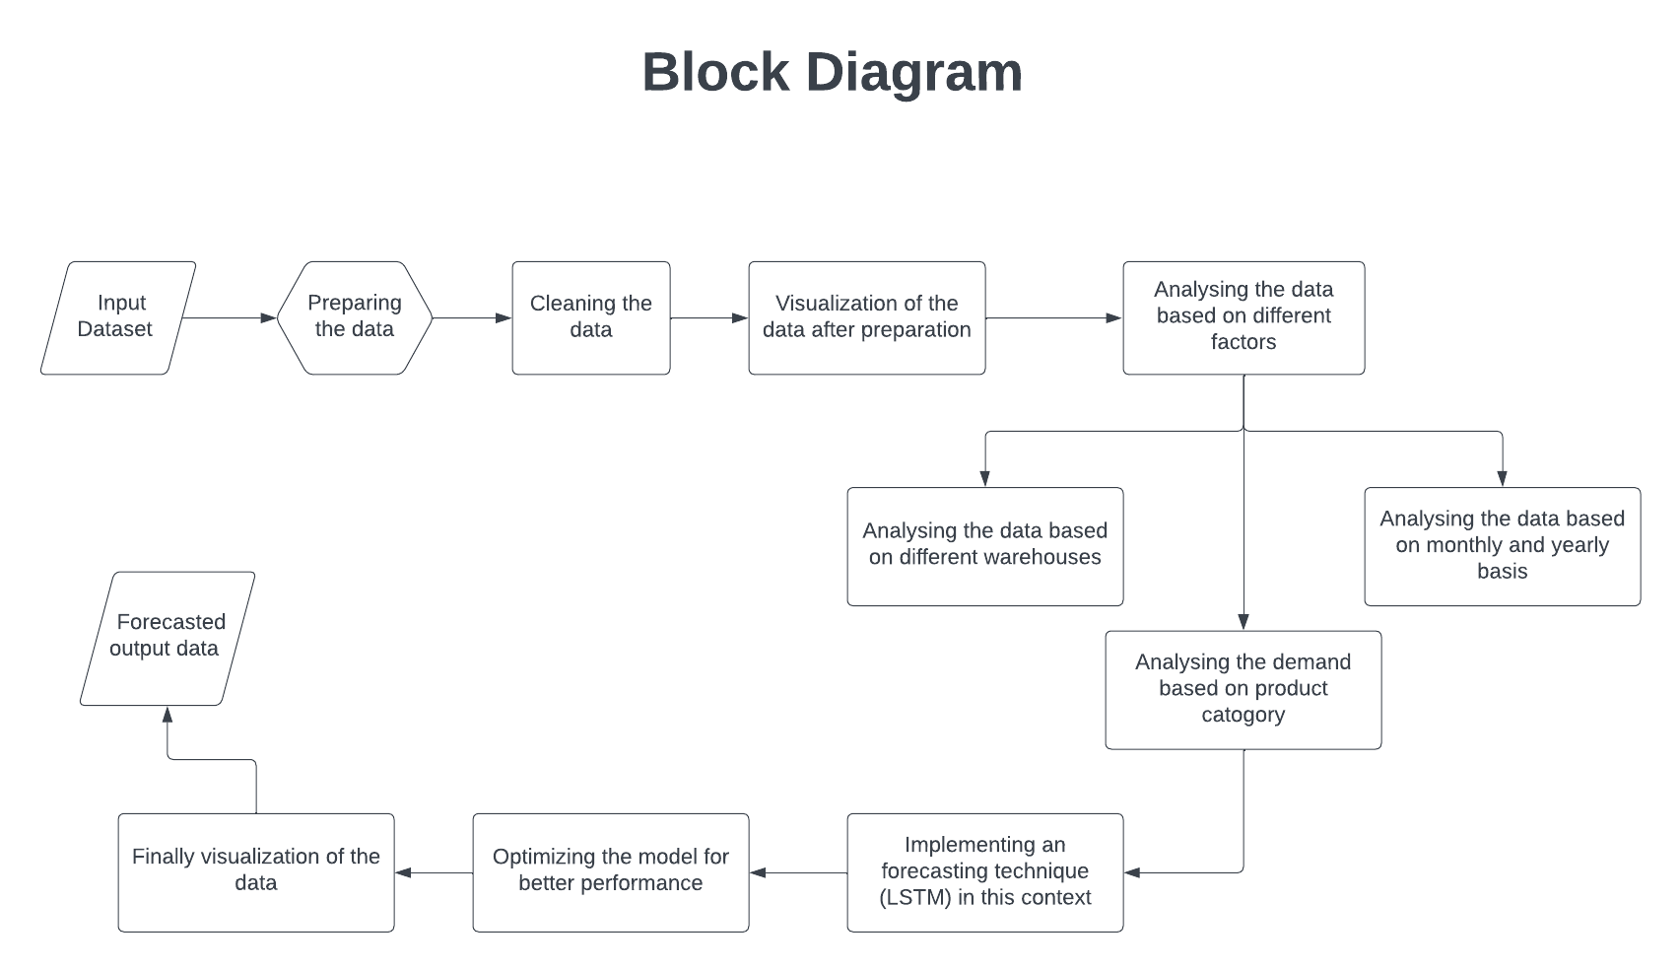
ARCHITECTURE DIAGRAM

Slide 11
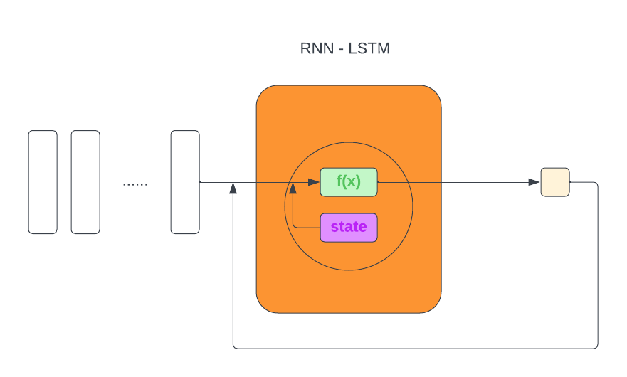
MODEL WORKING

Slide 12
CS8811
MAJOR PROJECT – ZEROTH REVIEW
THANK YOU

